Slide 1
Climate change adaptation in UK seafood Oceans Day at COP21 4 December 2015
Dr. Angus Garrett, Head of Horizon Scanning & Long Term Issues
Seafish, UK

Slide 2
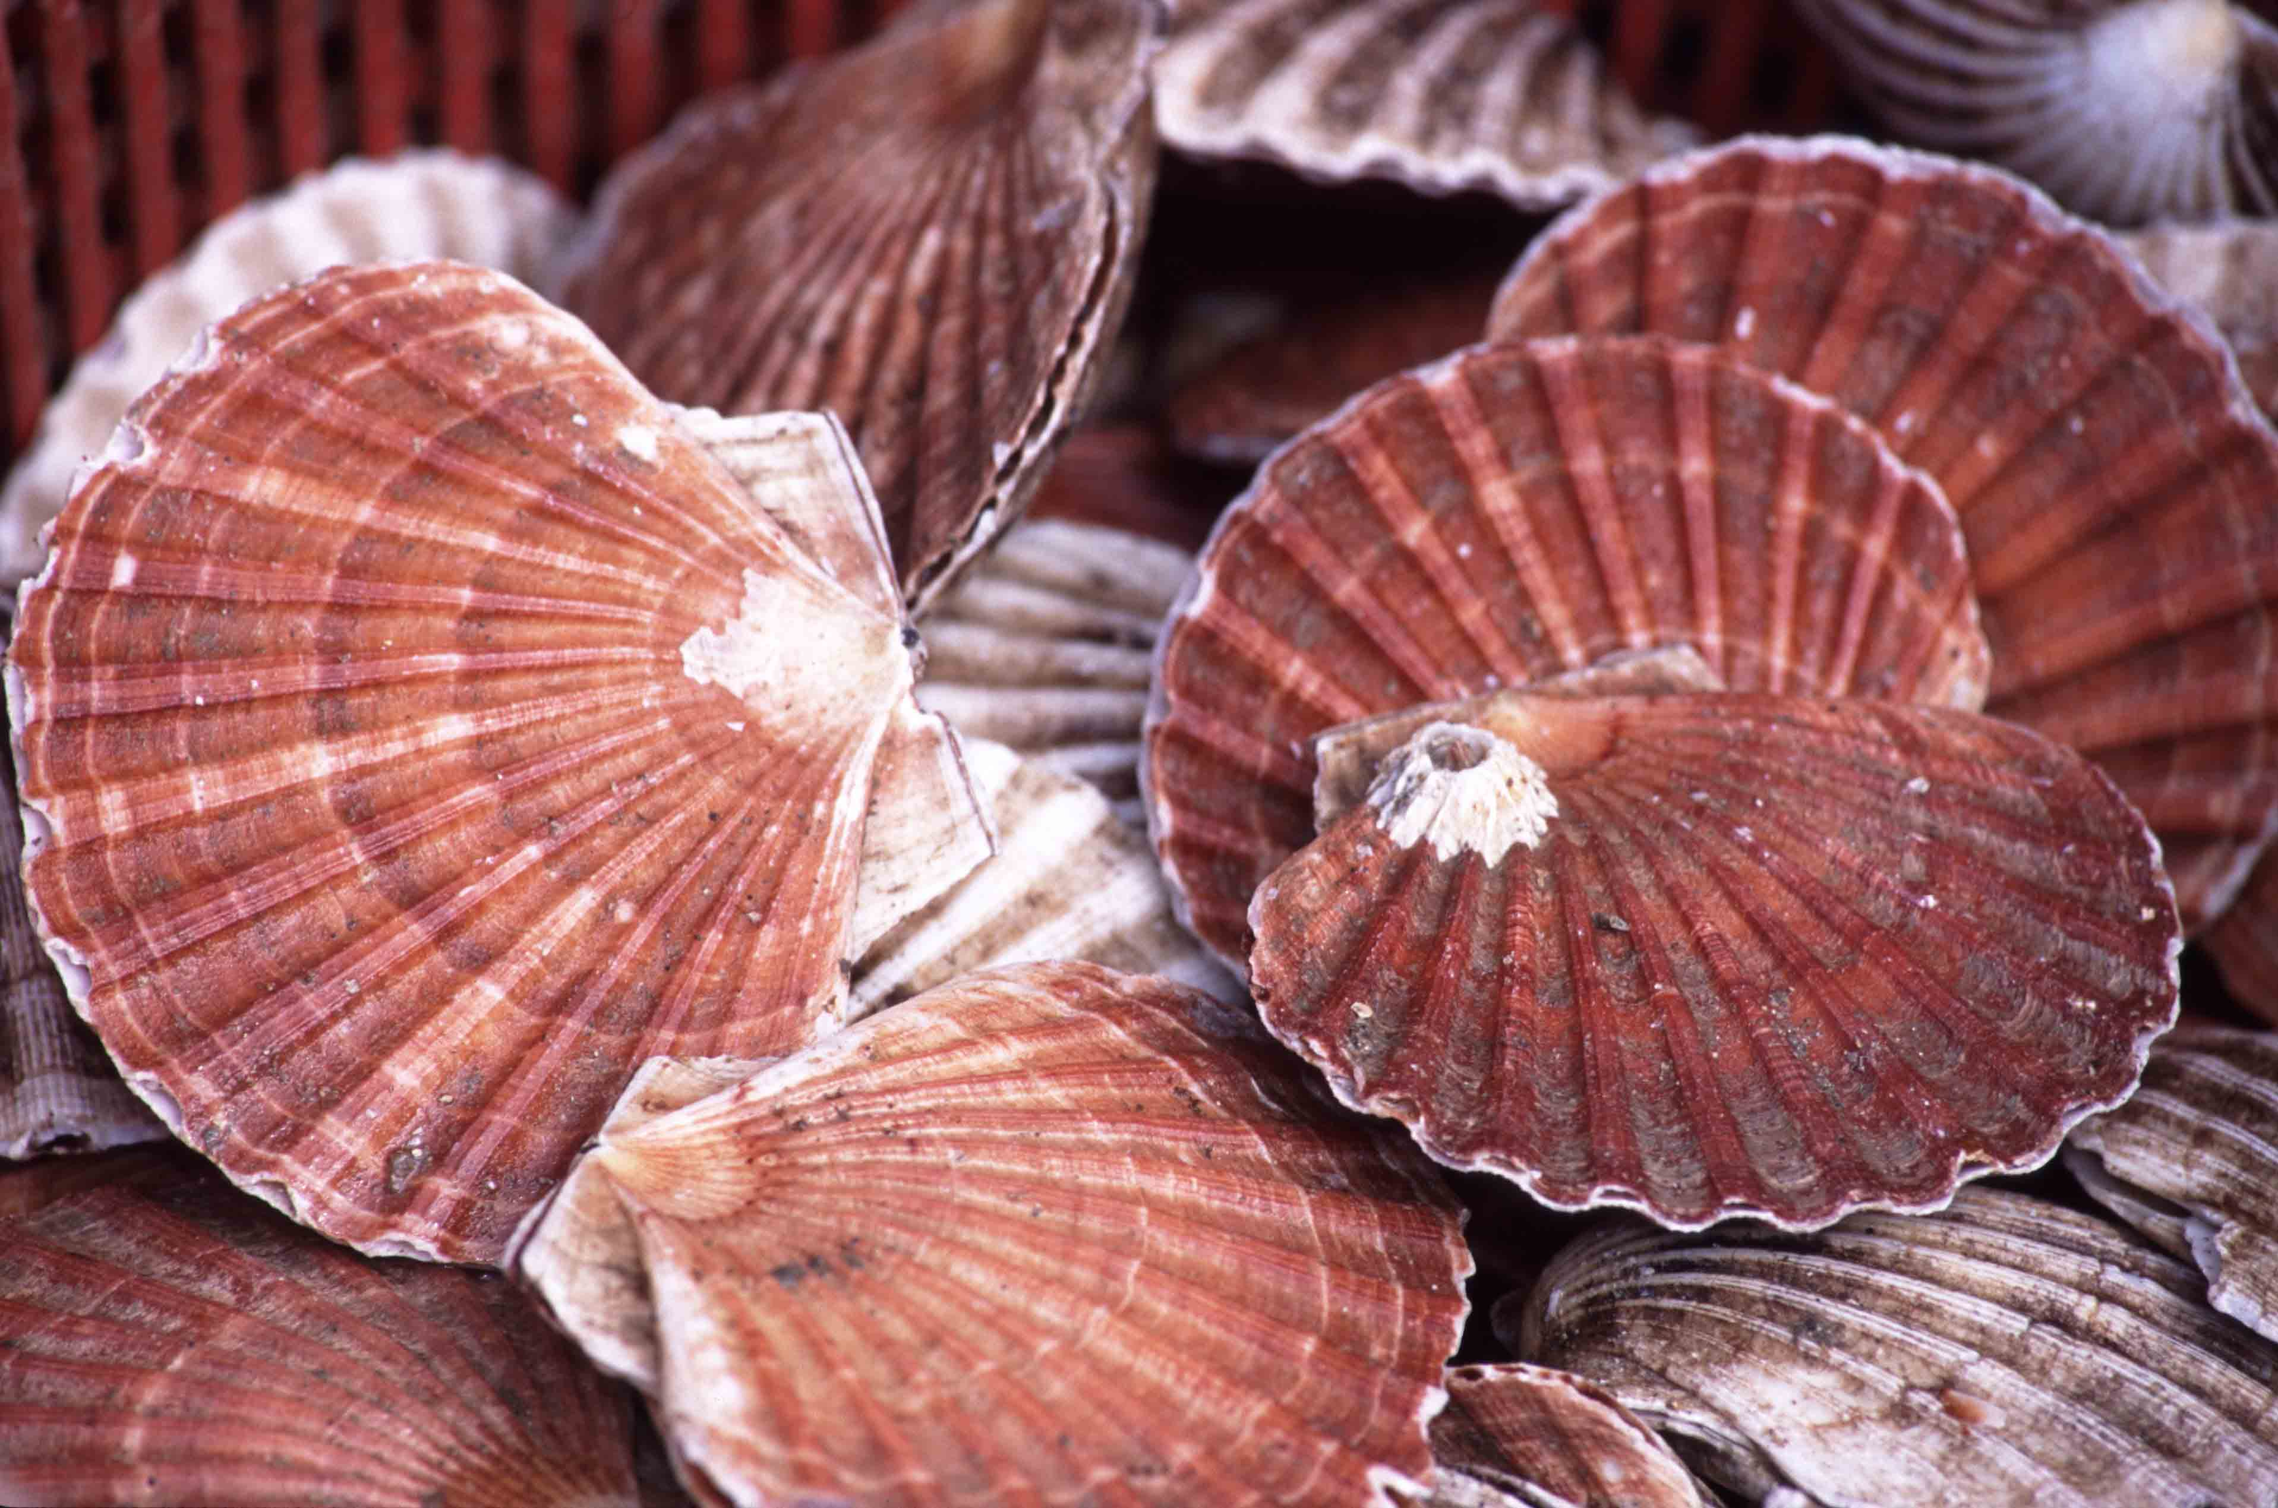
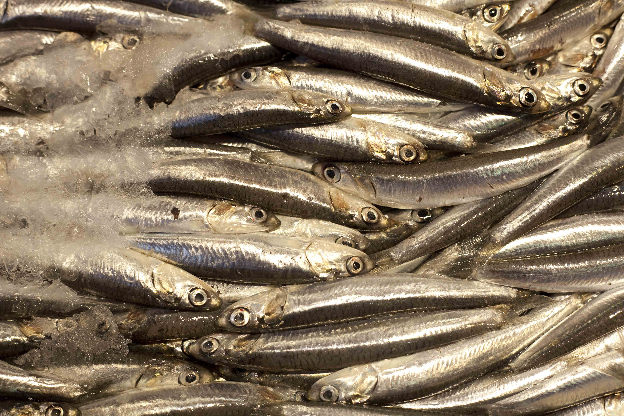
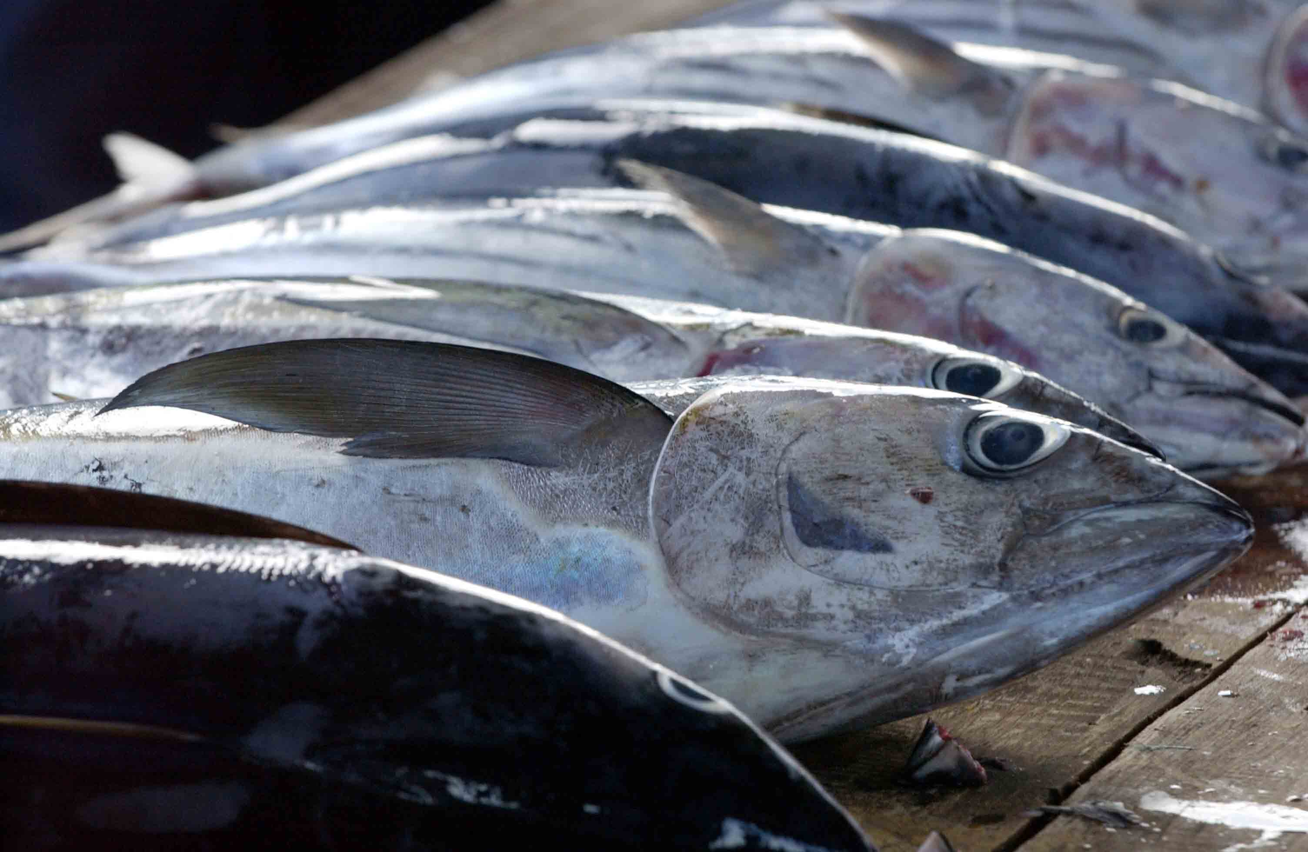
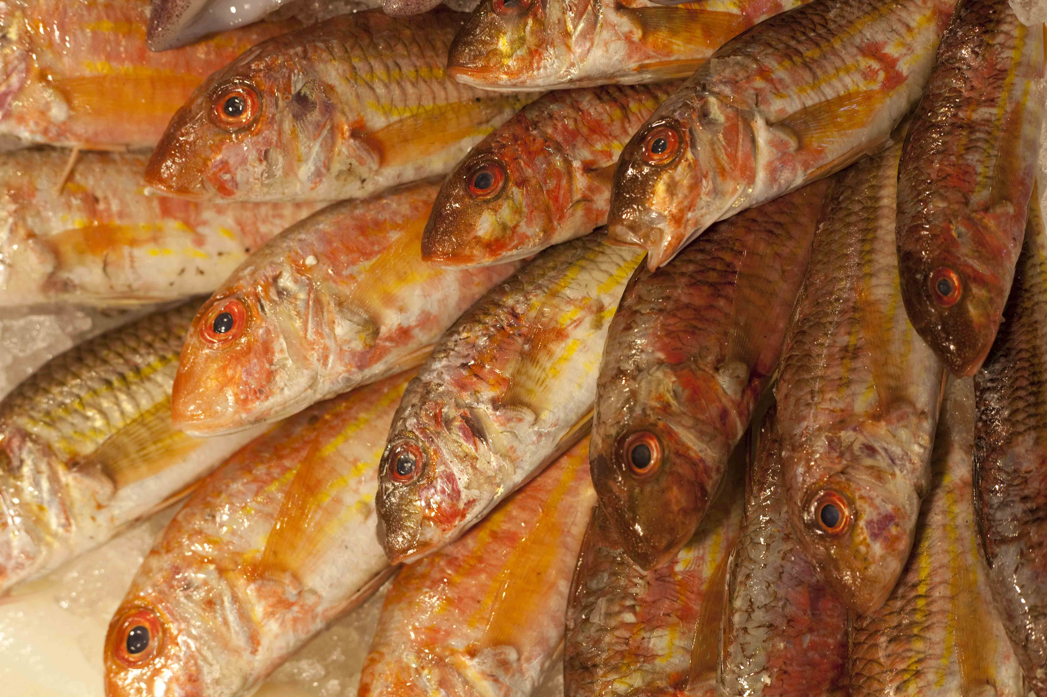
X
x

Slide 3
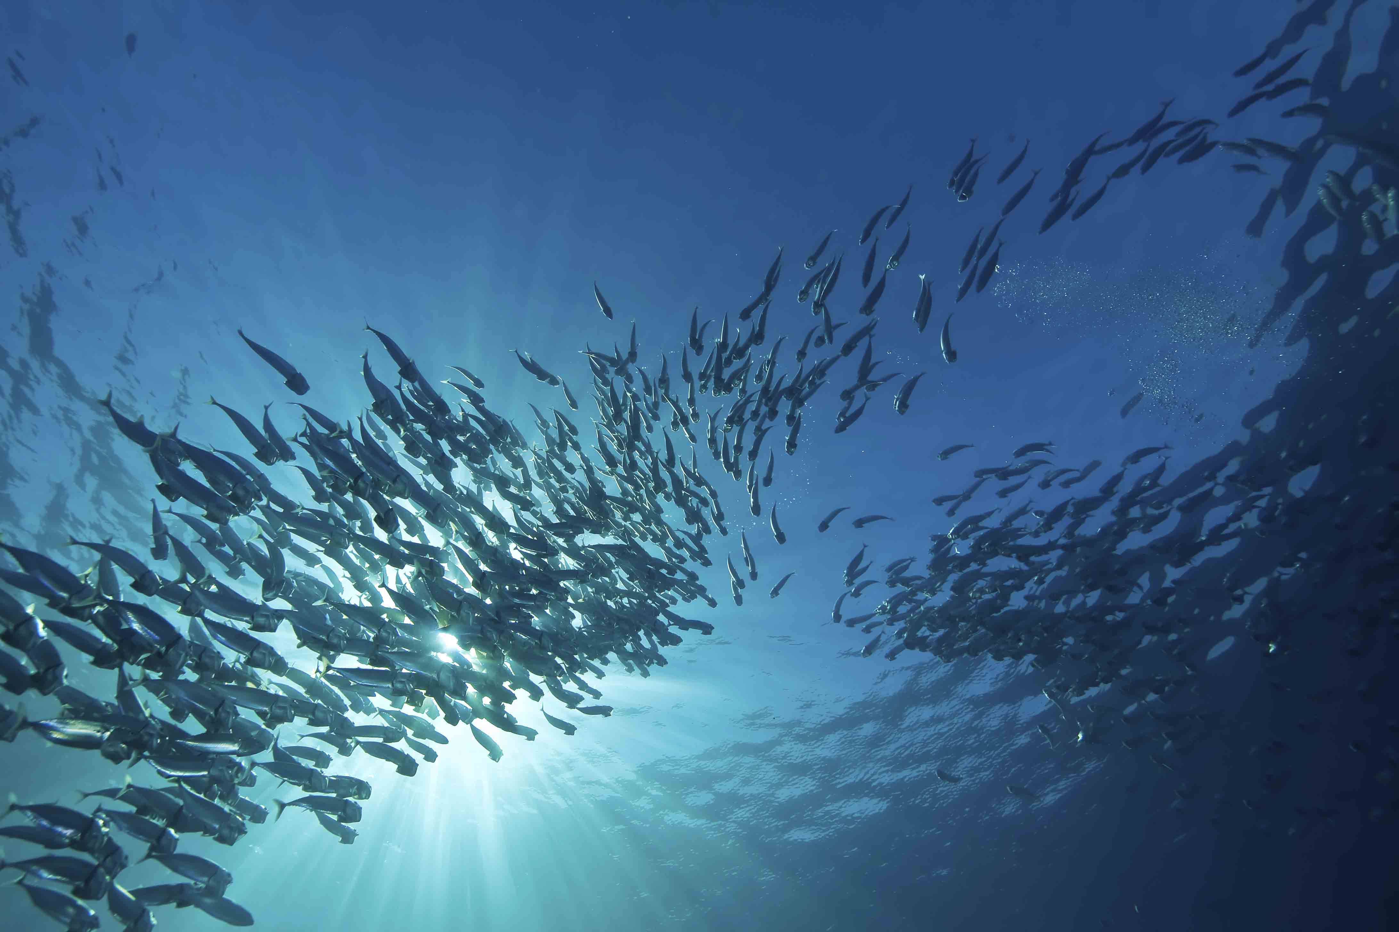
Industry landscape – diversity and dynamism

Slide 4
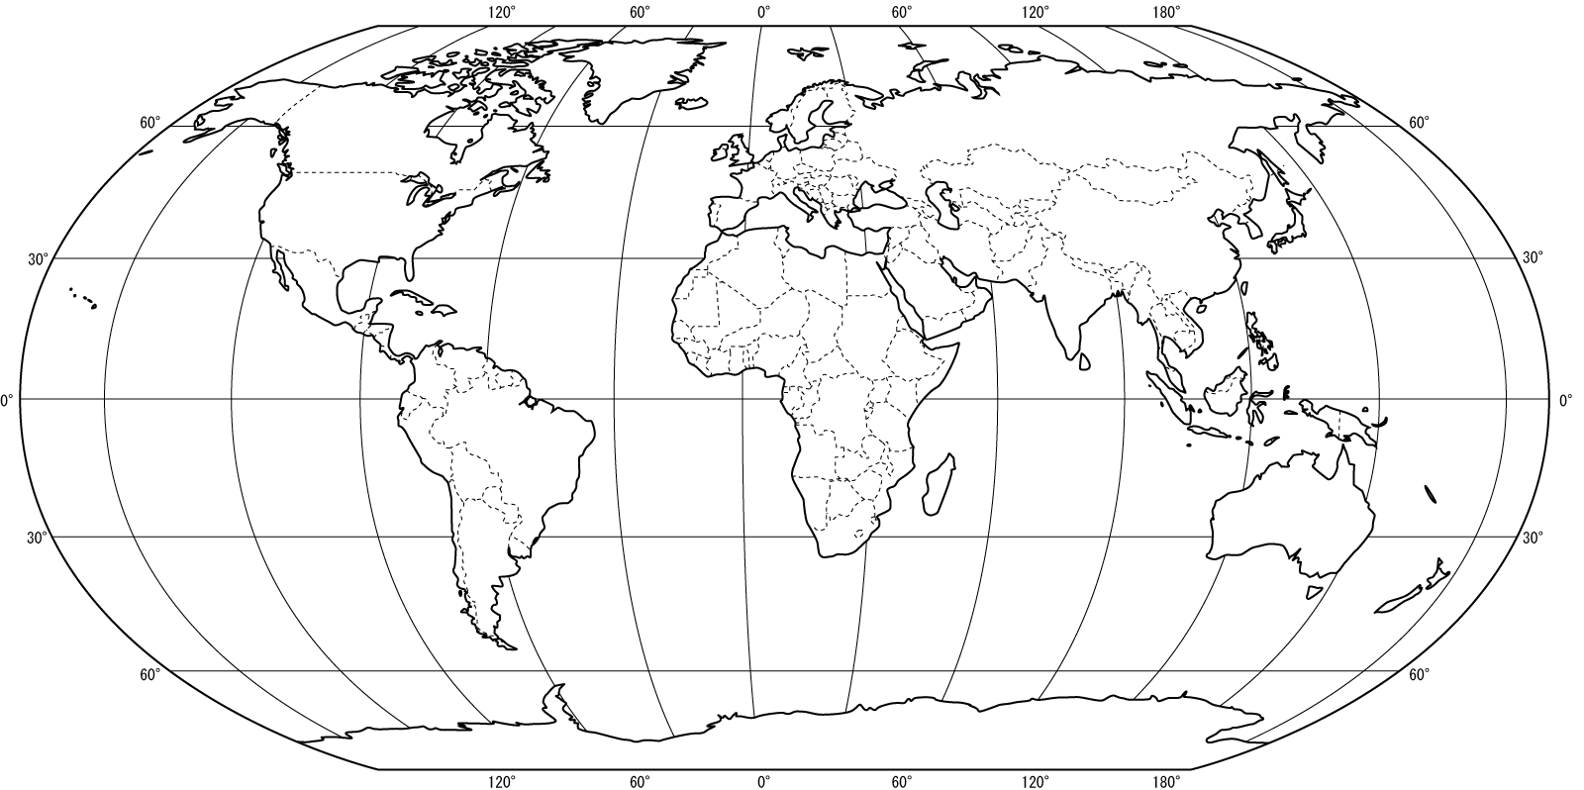

Slide 5
Summary points
Wild capture seafood:
An important resource, global and local.
Climate change a strategic challenge:
Sea level rise, storms and waves, temperature change, ocean acidification, changes in terrestrial rainfall.
Working with industry and experts to develop a managed adaptive approach
Combining scientific evidence with industry experience
Taking a broad view of food system landscape (not single nation)
Identifying opportunities as well as threats
Adaptation requires specific action in oceans and beyond
Review of key resources, fisheries governance, also onshore infrastructure, seafood marketing, requirement for well-functioning markets, etc.
Ongoing monitoring/feedback, linking various actors, etc.
Some responses already underway, others require closer collaboration.

Slide 6
Conclusion
Adaptation is already happening, how can we improve it?
Further information:
http://tinyurl.com/cc-adaptation-in-UK-seafood
Angus Garrett, angus.garrett@seafish.co.uk
Seafish, UNITED KINGDOM

